Slide 1
Clients Clustering
Stavrou Athanasios
Contoso
May 11, 2018
Contoso Clustering

Slide 2
The Clusters (year 2009)
Clients into 3 clusters
Sizes of 16319, 188, 1303 respectively (17810 total observations)
Analyze them regarding the monetary variables (average revenue per visit, total revenue, number of visits etc.)
The 2nd Cluster (187 observations) are Companies, 1st and 3rd Clusters are individuals
Contoso Clustering

Slide 3
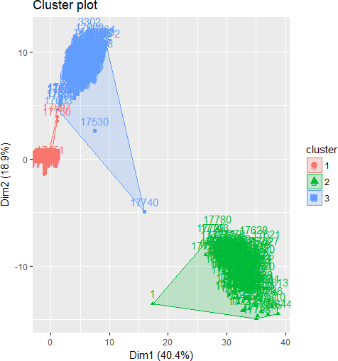
Cluster Plot
Contoso Clustering

Slide 4
Cluster Notes
Note 1
We have grouped our observations into 3 clusters, depending on their preferences regarding the products. This means that even though 2 clusters may have the same average products bought per visit, these products are not the same between the 2 clusters
Note 2
Use of more clusters has some unwanted effects, like observations belonging in 2 or more clusters
Note 3
After breaking our database down, we notice that we have some insignificant NA values in the 1st and 3rd Clusters, but significant in the 2nd Cluster. This is because the 2nd Cluster is a cluster filled with Companies (187 out of 188 obs)
Contoso Clustering

Slide 5
Ages by Clusters
 | N/A | 18-29 | 30-39 | 40-49 | 50-59 | 60+
Cluster 1 | 34 | 173 | 4551 | 5707 | 3374 | 2480
Cluster 2 | 187 | 0 | 0 | 1 | 0 | 0
Cluster 3 | 9 | 0 | 1 | 502 | 448 | 343
Table:Cluster’s Ages
From the above table, we see that most people in cluster 1 are between 30
- 49 years old, while on cluster 3 all individuals are of age 40+. Notice that very few individuals, in general, are younger than 30 years old. In the seconds cluster there is no meaning in analyzing the age, since we are talking about Companies.
Contoso Clustering

Slide 6
Best Selling Products by Clusters
 | Product 1 | % Total | Product 2 | % Total
Cluster 1 | Washers/Dryers | 38.42% | D/L Games | 34.68%
Cluster 2 | Camcoders | 9.34% | Washers/Dryers | 3.22%
Cluster 3 | Washers/Dryers | 35.89% | D/L Games | 3.25%
Table:Best Selling Products
As we can notice, the best selling product (due to the fact that 17622 of the total consumers belong in Clusters 1 and 3) was products in the Washers & Dryers category, receiving over 35% of the total spendings of the 2 clusters and 2nd best selling in Cluster 2. Notice that even though the 2nd best product in both 1 and 3 Clusters is the from the category ”Download Games”, the first Cluster spent almost 35% on it, while the 3rd Cluster spent only 3% of their total spendings.
Contoso Clustering

Slide 7
Yearly Income
Average Yearly Income
Cluster 1 73.897 e
Cluster 2 9.947.287 e
Cluster 3 198.204 e
Table:Yearly Income by Clusters
The Average Yearly Income has no meaning for the 2nd Cluster, it could be the Return on Assets (RoE), Return or Equity (RoE) or the year’s total revenues. When it comes to individuals, Cluster 3 has higher average yearly income.
Contoso Clustering

Slide 8
Marital Status by Clusters
 | N/A | Married | Single
Cluster 1 | 34 | 8763 | 7522
Cluster 2 | 187 | 1 | 0
Cluster 3 | 9 | 825 | 469
Table:Marital Status
We see that most people in the population are Married, but in Cluster 3 almost two out of three consumers are Married, while in Cluster 1 almost 50 percent are Married.
Contoso Clustering

Slide 9
Revenues / Units / Visits
Total Revenues | Units Sold | Average Visits
Cluster 1 37.097.453,00 e | 354.168 | 20
Cluster 2 792.429.016,00 e | 4.543.239 | 32
Cluster 3 28.201.572,00 e | 71.603 | 29
Table:Revenues by Product
This table gives us information about the Total Units Sold, their respective Revenues as well as how many times each individual in the respective clusters visited the stores. Obviously, the companies have spent the most of any other cluster, followed by Cluster 1. Notice that even though Cluster 1 has lower average yearly income has spent almost 9 million higher than the Cluster 3.
Contoso Clustering

Slide 10
Children & Gender
 | N/A | Average Children | Male | Female
Cluster 1 | 34 | 2 | 8211 | 8074
Cluster 2 | 187 | 0 | 1 | 0
Cluster 3 | 9 | 2 | 679 | 615
Table:Children & Gender
Once again, the total children and gender variables have no meaning when it comes to Cluster 2. We see that there are more Males than Females, but more or less they are half-half, with 2 children on average. This means that the children an individuals has, or their gender gives us no information regarding the Cluster they are in.
Contoso Clustering

Slide 11
Education
 | N/A | BSc. | MSc. | HS | Partial Col | Partial HS
Cluster 1 | 34 | 4861 | 2937 | 2604 | 4616 | 1267
Cluster 2 | 187 | 1 | 0 | 0 | 0 | 0
Cluster 3 | 9 | 455 | 243 | 213 | 345 | 38
Table:Education
Due to the bounded space, BSc. = College, MSc. = Graduate Degree, HS
= High School, Partial Col = Partial College and Partial HS = Partial High School. Leaving Cluster 2 aside, we see that in Clusters 1 and 2 most have gone to College (graduated or not), and that most of them finish High School. Almost 2 out of 3 individuals have been in College, in both Clusters.
Contoso Clustering

Slide 12
Continent Breakdown
 | Asia | Europe | North America
Cluster 1 | 3597 | 4869 | 7853
Cluster 2 | 35 | 19 | 134
Cluster 3 | 0 | 645 | 658
Table:Revenues by Product
We notice that the clusters are consisted of different Continents. More specifically, the Companies in Cluster 2 come mainly from North America, the most individuals in Cluster 1 come from North America, while in Cluster 3 the Continent of origin is split half-half between Europe and North America. Notice that 187 our of 230 companies come from NA, 34 from EU and 9 from Asia.
Contoso Clustering

Slide 13
Conclusions 1
In general, we have 3 Clusters, for the year 2009. These are differentiated by the revenues per product and have some different characteristics. The Cluster 2 is the richest one, bought the most units and brought the most revenues to the company. The mostly bought product come from the ”camcoders” category (9% of their total purchases) and their preferences vary, as the products they bought vary. In contrast, Cluster 1 mostly purchased only two categories, Washers/Dryers and Download Games (over 70% of the total purchases). Cluster 3 bought mostly Washers/Dyers, but they purchased many other products in small quantities. We also noted that most individuals / companies come from NA, followed by EU and Asia.
Contoso Clustering

Slide 14
Conclusions 2
Moving on, we have no other characteristics about the second cluster, due to the nature of the type of variable (being Companies). Regarding Clusters 1 and 3, we notice that Cluster 1 has lower average age than Cluster 3, as well as bigger size (number of customers that belong in it). It seems that the 2 clusters have the same percentages of Males / Females. Another characteristic that differs, is the fact that in Cluster 1 almost 1 in 2 people are married, while in Cluster 3 only 1 in 3 is married. Lastly, the 2 clusters have people with, more or less, the same level of education within its individuals. Most people have attended College, whether partially or fully.
Contoso Clustering

